Slide 1
DATA 468: Applied Stochastic Process
by
Dr. Zakir
Department of Mathematics University of Arizona
Email: zakir@arizona.edu

Slide 2
Outline
Finite Markov Chains
Countably infinite Markov chain
Stationary Distributions
Limiting Distributions
3
4
Notes:
Very nice difinitions of fundamentals : https://library.fiveable.me/theoretical-statistics/unit-10/markov-chains/study-guide/4CtMLvESxNdIeB3m

Slide 3
Finite vs Countably infinite Markov Chains
Finite Markov chains have a limited number of possible states, while countably infinite Markov chains have an infinitely large, yet countable, number of states.
This difference primarily affects the analysis and behavior of the chains, particularly regarding recurrence, transient states, and stationary distributions.

Slide 4
Finite Markov Chains
State Space: A finite set of possible states, often represented as {1, 2, ..., M}.
Analysis: Can be conveniently analyzed using matrices and vectors, simplifying calculations and analysis.
Recurrence: If the chain is irreducible (all states can be reached from each other), it is always recurrent, meaning every state will be visited infinitely often.
Stationary Distribution: Existence of a stationary distribution is guaranteed under certain conditions, such as irreducibility and aperiodicity.
Applications: Random walks on graphs, traffic flow models, and simple state machines.

Slide 5
Countably Infinite Markov Chains
State Space: An infinite set of possible states, often represented as {0, 1, 2, ...}.
Analysis: More complex than finite chains, with a greater need for rigorous mathematical analysis.
Recurrence: States can be transient (visited only a finite number of times) or recurrent (visited infinitely often). Recurrent states can be further classified as positive recurrent (finite expected return time) or null recurrent (infinite expected return time).
Stationary Distribution: Exists under specific conditions, including irreducibility, aperiodicity, and positive recurrence.
Applications: Queueing theory, modeling the number of customers in a queue, and branching processes.

Slide 6
Key Differences Summarized
Feature | Finite Markov Chains | Countably Infinite Markov Chains
State Space | Finite (M) | Countably Infinite (0, 1, 2, ...)
Recurrence | Always recurrent | Can be transient or recurrent
Stationary Distribution | Guaranteed under certain conditions | Guaranteed under certain conditions
Analysis | Easier, uses matrices | More complex, requires rigorous analysis
Examples | Random walks, simple state machines | Queueing theory, branching processes

Slide 7
Outline
Finite Markov Chains
Countably infinite Markov chain
Stationary Distributions
Limiting Distributions
3
4
Notes:
Very nice difinitions of fundamentals : https://library.fiveable.me/theoretical-statistics/unit-10/markov-chains/study-guide/4CtMLvESxNdIeB3m

Slide 8
Stationary Distribution
A stationary distribution is a probability distribution π over the states of a Markov chain such that, if the chain starts in π, it remains in π at all future time steps.
πP=π
It’s a distribution that doesn’t change over time under the Markov process.
Exists When: The Markov chain is irreducible and positive recurrent (not necessarily aperiodic).

Slide 9
Stationary distributions
Let {X_{n}} be a Markov china with state space S={1,2,3,…r} and one step transition probability matrix P. The limiting distribution π={π₁, π₂, π₃,… π_{r}} of {X_{n}}, If it exist is the unique non-negative roots of the equation
Where equation (1) can also be expressed in the form
π= πP
Notes:
https.//www.hamilton.ie/ollie/Downloads/Mar1.pdf

Slide 10
Find the stationary distribution of a Markov china
The stationary distribution provides the long-term probabilities of being in each state in which remain constant over time for the Markov chain.
πP = π
π =[π₁, π₂]
Solve the System of Equations
Notes:
https.//www.stat.auckland.ac.nz/~fewster/325/notes/ch1annotated.pdf

Slide 11
Outline
Finite Markov Chains
Countably infinite Markov chain
Stationary Distributions
Limiting Distributions
3
4
Notes:
Very nice difinitions of fundamentals : https://library.fiveable.me/theoretical-statistics/unit-10/markov-chains/study-guide/4CtMLvESxNdIeB3m

Slide 12
Transient distribution
Transient distribution and limiting distribution refer to different stages or types of behavior of the chain over time.
The transient distribution describes the probability distribution of the states at a particular finite time step.
If you start with an initial distribution π⁽⁰⁾, then the transient distribution after n steps is.
π^{(n)}=π⁽⁰⁾P^{n}
Key Point. This distribution can change at each time step and does not necessarily converge to a fixed value.
Notes:
https.//www.stat.auckland.ac.nz/~fewster/325/notes/ch1annotated.pdf

Slide 13
Transient and limiting behavior
Transient behavior
Limiting behavior
Notes:
https://resing.win.tue.nl/SOR/eng/college3_09_eng.pdf

Slide 14
Limiting distributions
So far we have studied transitions between different states , which describe short-time behavior of the chain.
What is of interest, however, is the long-term behavior of the system, measured in million/billions of steps.
In Stock Exchange, there is a trade every few seconds , and each trade changes the price (state) a little bit.
Investor are interested in long term distribution of the stock-price in 6 months, in a year or, in 30 years.
Notes:
https.//www.hamilton.ie/ollie/Downloads/Mar1.pdf
https://web.ma.utexas.edu/users/gordanz/notes/stationary_distributions_color.pdf

Slide 15
Limiting Distribution
A distribution where the Markov chain converges to as time goes to infinity, regardless of the starting distribution.
for all states i, if the limit exists and is the same for all i.
Interpretation: It’s the long-run probability of being in each state, starting from any initial distribution.
Exists When: The Markov chain is irreducible, positive recurrent, and aperiodic (i.e., ergodic).

Slide 16
Limiting distribution
The limiting distribution (also called the stationary distribution, when it exists and the chain is ergodic) is.
Ergodic. it means the chain satisfies certain conditions that ensure it will converge to a unique long-run (stationary) distribution, regardless of where it starts.
Formally, a Markov chain is ergodic if.
Irreducible. Every state can eventually be reached from every other state (possibly in multiple steps).
Aperiodic. The chain does not get trapped in cycles,in other words, the system does not return to a state at fixed multiples of some integer greater than 1.
Positive recurrent. The expected return time to each state is finite.
Notes:
https.//www.stat.auckland.ac.nz/~fewster/325/notes/ch1annotated.pdf

Slide 17
Limiting distribution
In the example we have, given the initial distribution π(0) = [1,0,0,0,0], that
π⁽¹⁾ = π^{(0) .} P = [0.1, 0.7, 0, 0.2, 0];
π⁽²⁾ = π^{(0) .}P² = [0.045, 0.140, 0.525, 0.290, 0];
π⁽³⁾ = π^{(0) .}P³ = [0.0115, 0.0455, 0.1050, 0.3393, 0.4987],
π⁽⁴⁾ = π^{(0) .} P⁴ = [0.0034, 0.0126, 0.0341, 0.3514, 0.5985],
π⁽⁵⁾ = π^{(0) .}P⁵ = [0.0010, 0.0037, 0.0095, 0.3550, 0.6308],
π⁽¹⁰⁾ = π^{(0) .}P¹⁰ = [0.0000, 0.0000, 0.0000, 0.3564, 0.6435],
π⁽¹⁰⁰⁾ = π^{(0) .} P¹⁰⁰ = [0.0000, 0.0000, 0.0000, 0.3564, 0.6435],
The distribution seems to converge and is no longer depend on the initial distribution
Notes:
https.//www.stat.auckland.ac.nz/~fewster/325/notes/ch1annotated.pdf

Slide 18
Limiting distribution
Questions that we like to answer:
Does the limiting distribution always exist?
If the limiting distribution exists, is it unique?
(Does the limiting distribution depend on the initial distribution of the Markov chain? Or do you always have, independent of the initial distribution, the same limiting distribution?)
How do you compute the limiting distribution, if it exists?
Let us first look at some simple examples.
Notes:
https.//www.stat.auckland.ac.nz/~fewster/325/notes/ch1annotated.pdf

Slide 19
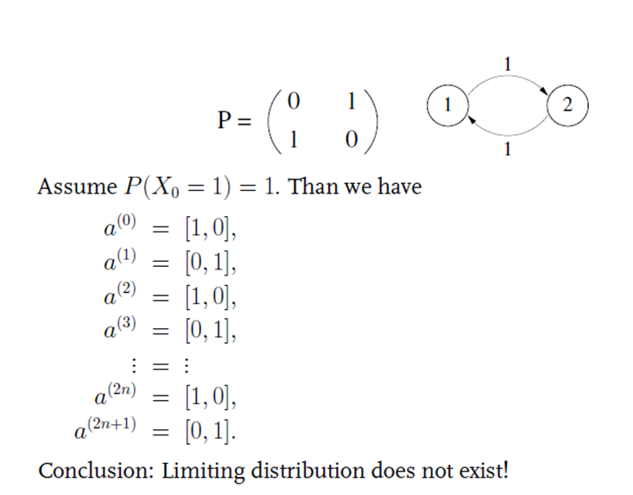
Limiting distribution: Example 1
Notes:
https.//www.stat.auckland.ac.nz/~fewster/325/notes/ch1annotated.pdf

Slide 20
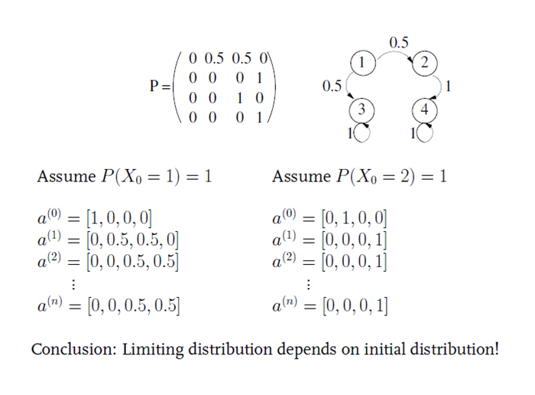
Limiting distribution: Example 2
Notes:
https.//www.stat.auckland.ac.nz/~fewster/325/notes/ch1annotated.pdf
https://youtu.be/7iP_xumbI4U?si=m_YvTZDpjnPw2pIl

Slide 21
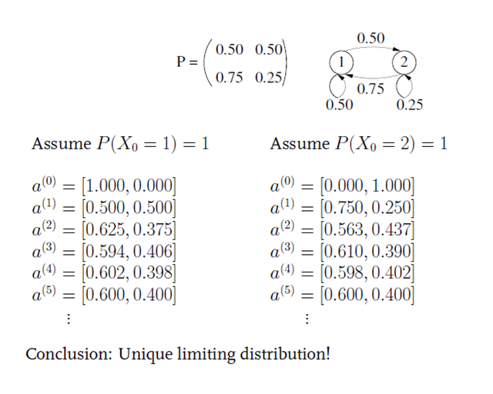
Limiting distribution: Example 3
Notes:
https.//www.stat.auckland.ac.nz/~fewster/325/notes/ch1annotated.pdf

Slide 22
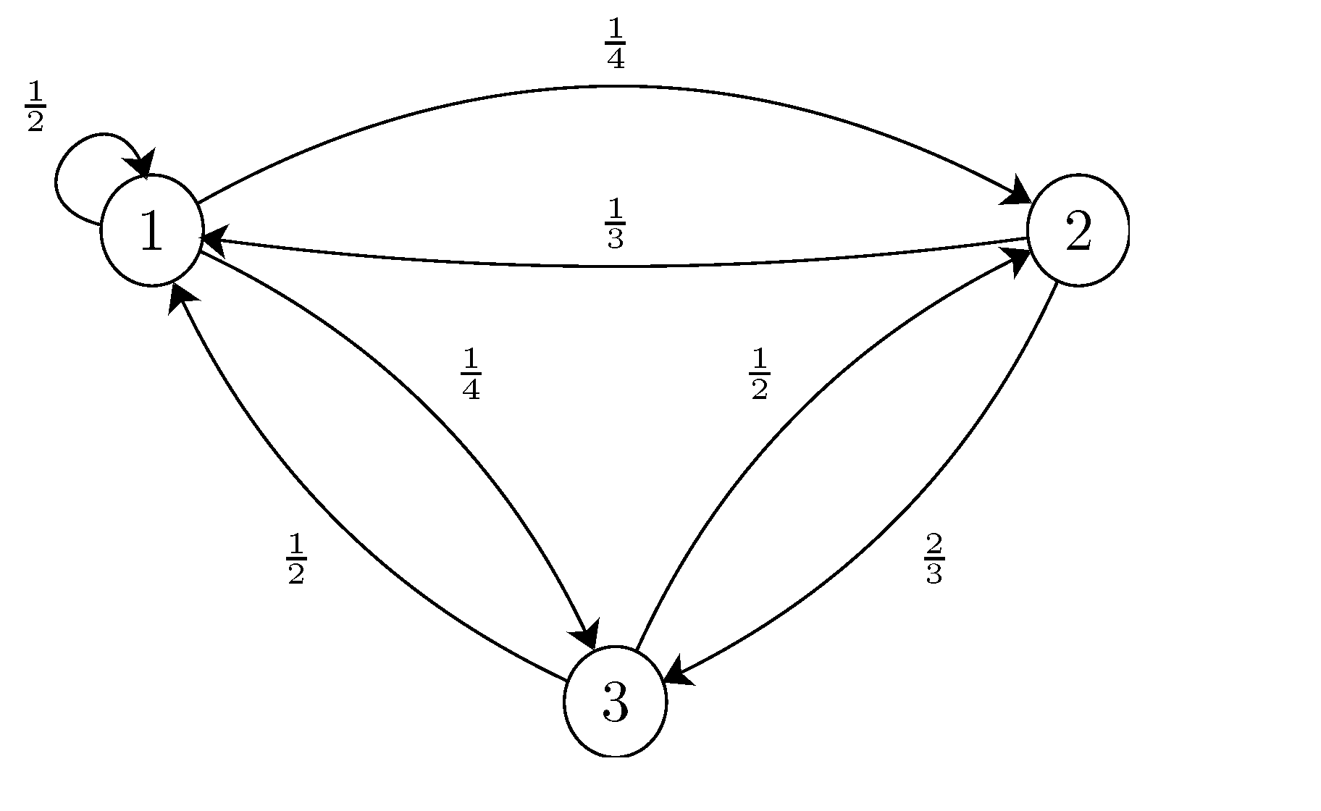
Limiting distribution
Is this chain irreducible?
Is this chain aperiodic?
Find the stationary distribution for this chain.
Is the stationary distribution a limiting distribution for the chain?
Notes:
https://www.stat.auckland.ac.nz/~fewster/325/notes/ch1annotated.pdf
https://www.probabilitycourse.com/chapter11/11_2_7_solved_probs.php

Slide 23
Limiting distribution
a). The chain is irreducible since we can go from any state to any other states in a finite number of steps.
b). Since there is a self-transition, i.e., P11>0(GDC=1), we conclude that the chain is aperiodic.
c).To find the stationary distribution, we need to solve
π₁=1/4π₁+1/3π₂+1/2π₃,
π₂=1/2π₁,
π₃=1/4π₁+2/3π₂+1/2π₃,
π₁+π₂+π₃=1
We find
π₁=3/8 ,π₂=3/16,π₃=7/16.
Since the chain is irreducible and aperiodic, we conclude that the above stationary distribution is a limiting distribution.
Notes:
https://www.stat.auckland.ac.nz/~fewster/325/notes/ch1annotated.pdf

Slide 24
Random Variables
Limiting and stationary distribution are the same if
If the chain is:
Finite,
Irreducible,
Aperiodic,
Not all the all the stationary distribution are limiting distributions
Notes:
https://www.stat.auckland.ac.nz/~fewster/325/notes/ch1annotated.pdf

Slide 25
limiting distribution
If a Markov process converges, then it converges to a stationary distribution. So yes, the limiting distribution is a stationary distribution.
However, not every stationary distribution is the result of convergence unless the Markov chain satisfies certain conditions.
This has a stationary distribution π=[0.5,0.5], but the chain doesn't converge because it flips back and forth (it's periodic). So, there's a stationary distribution but no convergence from every start.
Notes:
Very good one: https://resing.win.tue.nl/SOR/eng/college3_09_eng.pdf

